Slide 1









CARDIOVASCULAR DISEASE

Slide 2





ABOUT ME
Name: Savina B
Background: Data Analysis & Biomedical Science
Motivation:
Desire to make a broader impact in medical research
Opportunity to apply data-driven approaches to healthcare
Career Goals:
Contribute to advancements in medical research
Improve patient outcomes through data analysis
Bridge the gap between science and data-driven insights

Slide 3






SKILLS

Slide 4
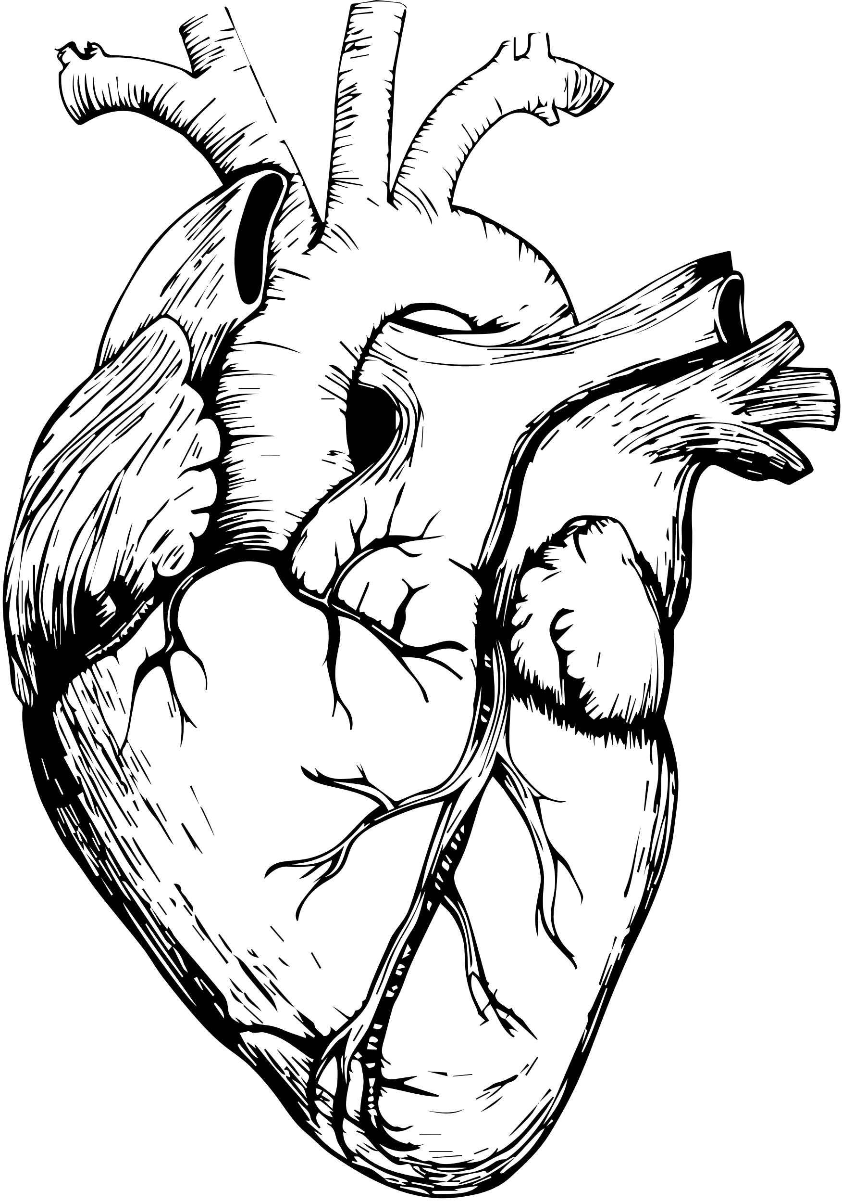

PROJECT TOPIC:
Cardiovascular Disease - Risk Factors Analysis
The Problem:
Cardiovascular disease (CVD) is a leading cause of death, with high mortality rates and severe health complications.
Early detection is critical but often limited, leading to life-threatening events like strokes and heart attacks.

Slide 5





SYBIL JONES’ STORY
Background: Mother of three, married to a Navy officer.
Event: Experienced a stroke at a farewell party.
Diagnosis: MRI revealed a brain clot due to undetected cardiovascular disease.
Outcome: Underwent clot removal; extensive recovery.

Slide 6
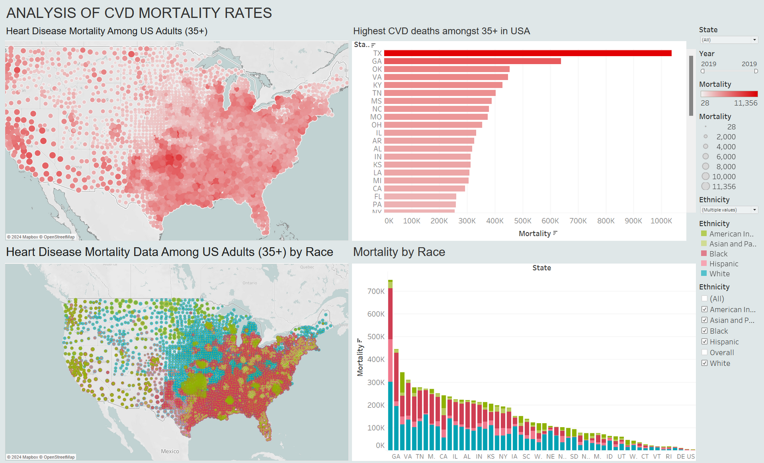

TABLEAU DASHOARD
Heart Disease Mortality Rates (2019, CDC): Highest in TX, GA, OK, VA, KY; lowest in DC, DE, GU, HI, VI.
Ethnic Distribution and Cardiovascular Mortality (Census 2022): BAME community makes up 43.6% of the US population, predominantly on the East Coast, with higher mortality rates suggesting ethnicity.

Slide 7


AIM AND IMPORTANCE OF ADDRESSING THE PROBLEM:
Early Detection
Reducing Mortality
Addressing Health Disparities
Informing Public Health Policy

Slide 8


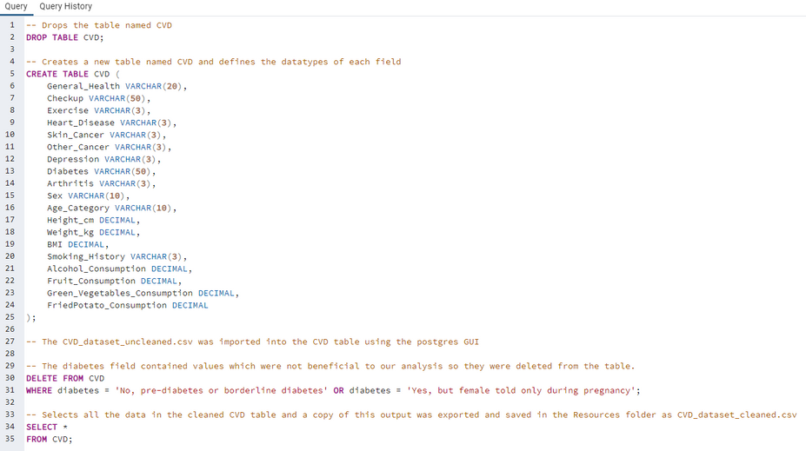
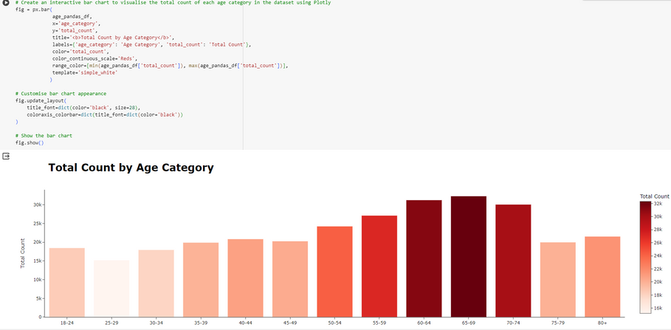
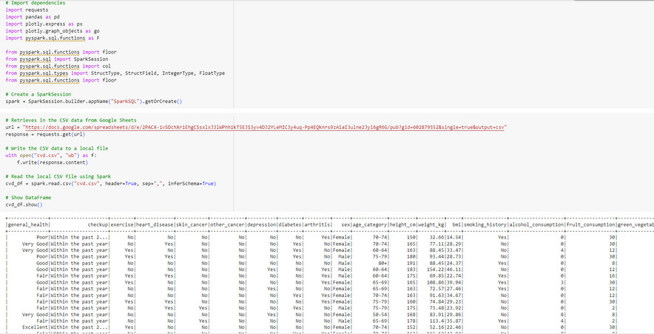
DATA CLEANING - SQL
Initial CSV dataset from Behavioral Risk Factor Surveillance System Dataset, DCP 2021
Cleaned via SQL
Visualisations created using Plotly

Slide 9
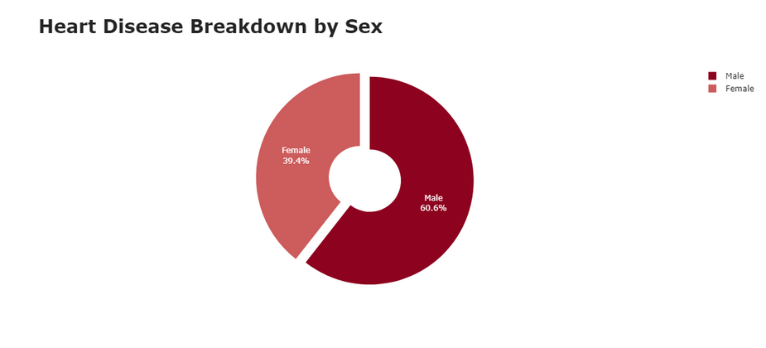
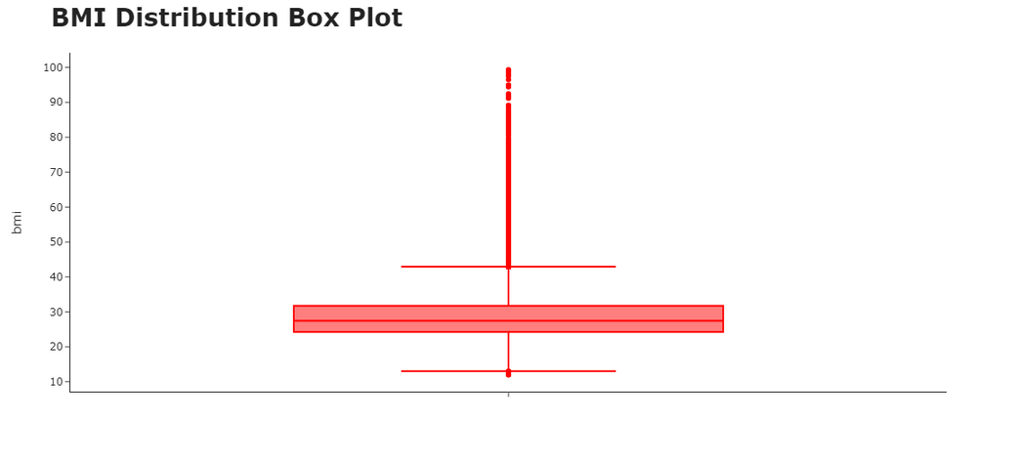
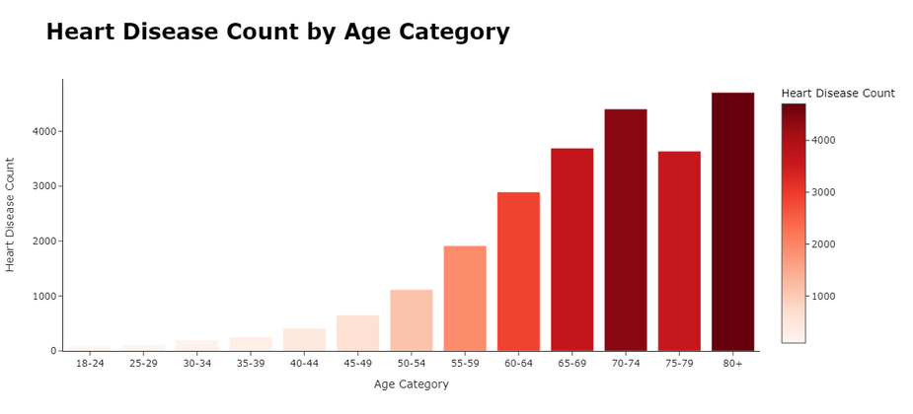
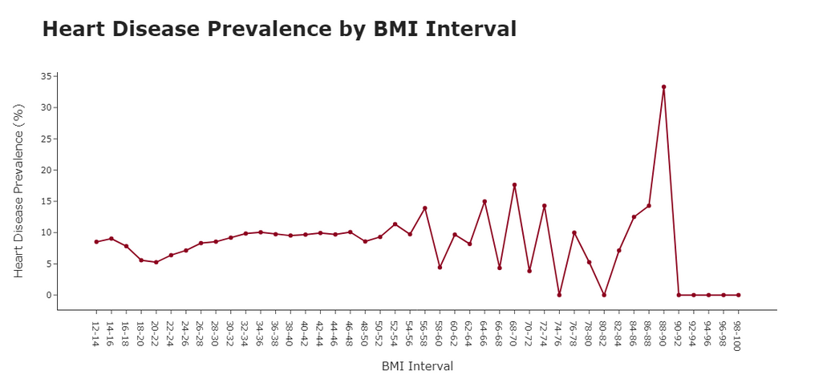
PYTHON ANALYSIS

Slide 10
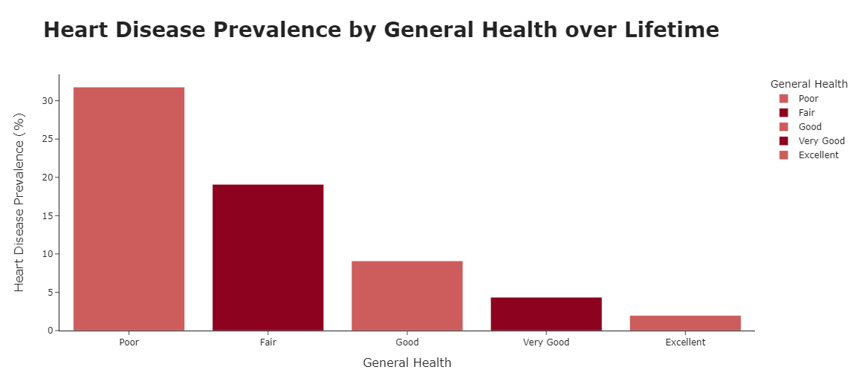
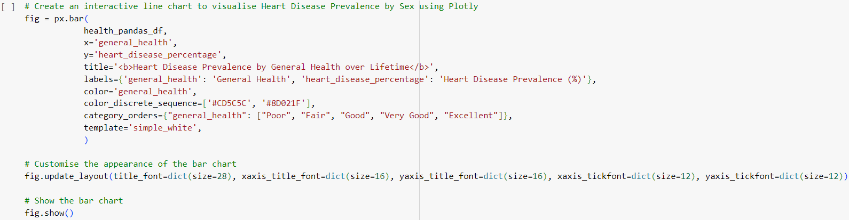
PYTHON ANALYSIS
The visualisation shows people with poor general health had a higher incidence of CVD

Slide 11




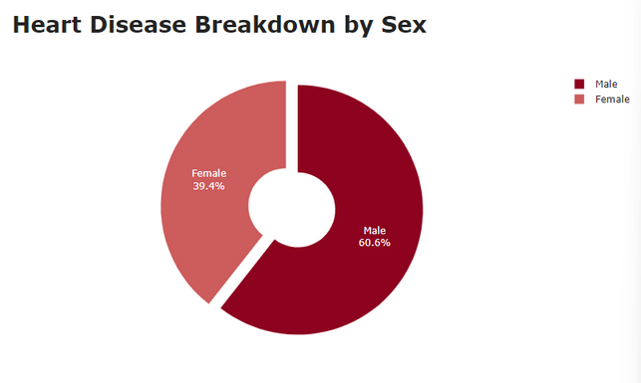
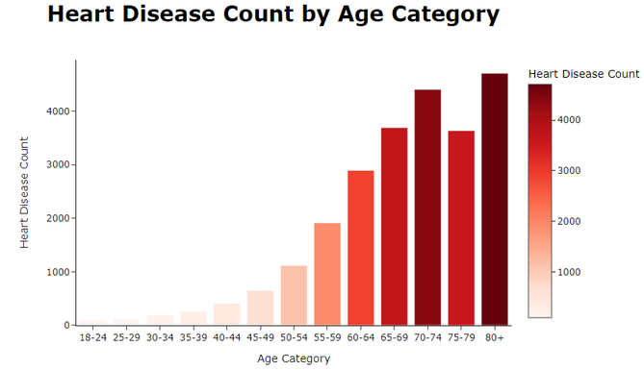
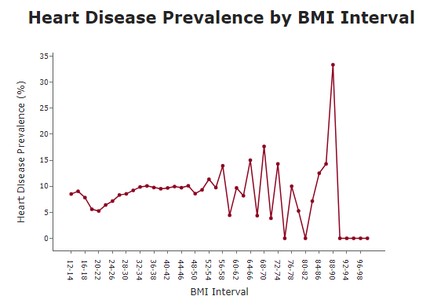

INSIGHTS
Gender Disparities
Age-Related Trends
BMI
Higher prevalence of heart disease in men (x 1.5 higher than in women)
Relationship between age and heart disease - increase in risk as age increases (first peak at age 40)
Unclear correlation, however, heart disease prevalence peak occurs at BMI of 88-90

Slide 12

CHALLENGES
Data Imbalance - Imbalance between cases with and without heart disease in the original dataset.
Data Limitations - Data is geographically restricted to United States.

Slide 13

RECOMMENDATIONS
Promote Regular Health Checkups to enable early detection of cardiovascular disease
Target Lifestyle Factors such as exercise and smoking cessation
Gender-specific strategies, given the higher prevalence of cardiovascular disease among males
Expand Data Sources to address data imbalances

Slide 14


THANK YOU

